Slide 1
Let’s Chat About OSC
Hans Hinrichsen

Slide 2
What is OSC
Flexible and customizable protocol – used in music, theatre, and live event applications
Designed as the replacement to MIDI using networking technology
Simple to understand
Very powerful and expandable
Let’s look at OSCWidgets!

Slide 3
What makes an OSC command?
An OSC Pattern followed by zero or more arguments
Patterns are defined by the control software you are working with
Eos: /eos/cue/1/fire
ColorSource: /cs/playback/go
Hog: /hog/playback/go/0
QLab: /workspace/1/go

Slide 4
OSC Arguments
Arguments are extra pieces of data sent with a Pattern
There can be many types – the controller you use will tell you what types to send
The standard defines:
Integer (…-2, -1, 0, 1, 2, 3, ….)
Floating point number (1.0001, -9.889, etc…)
OSC-Timetag (number of fractional seconds since January 1, 1900)
OSC-String (“Hello world!”)
OSC-blob (binary data)

Slide 5
What makes an OSC argument?
Here are some example arguments for real-world patterns
Eos:
Command: /eos/cue/fire
Argument: 1
Result: Run cue 1
ColorSource:
Command: /cs/playback
Arguments: 12, “fire”, 1
Result: Pressed the bump button DOWN for playback 12
Hog:
Command: /hog/hardware/fader/0
Argument: 127
Result: Sets the Hog 4 Grand Master to 50% (0-255 range)

Slide 6
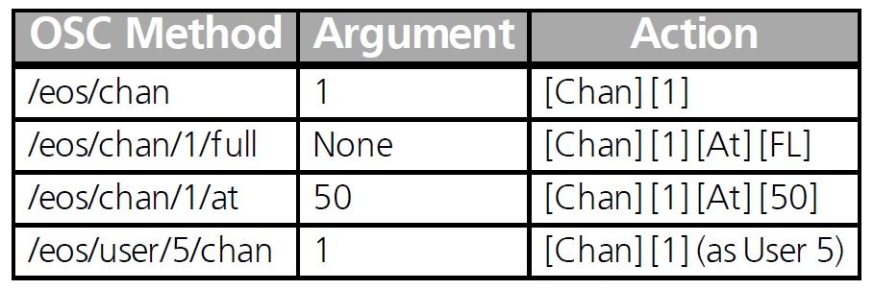
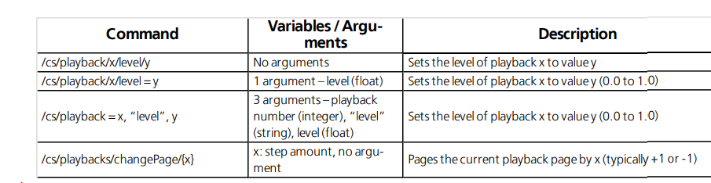
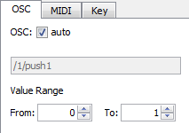
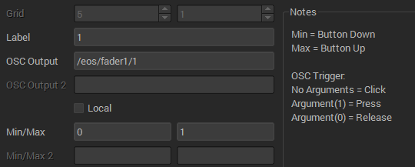

OSC Messages
Entering arguments in software will vary based on the platform used to send them!
TouchOSC
Eos Magic Sheets
OSCWidgets

Slide 7
How do I know what commands are supported?
Check the user manuals and/or online help pages
Eos: http://www.etcconnect.com/webdocs/Controls/EosFamilyOnlineHelp/Default.htm
Hog: https://www.highend.com/pub/support/controllers/documents/HTML/en/sect-osc_mappings.htm
ColorSource AV User Manual: http://www.etcconnect.com/WorkArea/DownloadAsset.aspx?id=10737495606
QLab: https://figure53.com/docs/qlab/v3/scripting/osc-dictionary-v3/

Slide 8
Connecting devices
OSC is transport-independent protocol
A few ETC has used:
UDP
TCP/IP – packet length headers
TCP/IP – SLIP
USB/Serial
Let’s talk details about IP-based…

Slide 9
OSC – UDP vs TCP
IP: UDP vs TCP
User Datagram Protocol
Stateless – no “connection”
Does not guarantee message reaches destination
Transmission Control Protocol
Direct connection
Guaranteed delivery
Two OSC versions – 1.0 (packet length) and 1.1 (SLIP)
Must match for two devices to talk to each other!
IP: Ports
An endpoint or “mailbox” associated with an IP address
10.101.2.177:53000

Slide 10
Choosing Ports
TCP
TCP ports are typically hard-coded and listed in documentation
Usually a single TCP port is available
Each device has a unique connection to the controller
Controller can respond directly to a device
UDP
UDP ports are typically configured
The Receive (Rx) port is typically different than the Transmit (Tx) port
Any device can send to the Rx port
Controller is typically configured to transmit to a single IP address and port (or has to be configured for each IP you want to send to)

Slide 11
Questions

Slide 12
Real World Uses of OSC
Lightwright 6
Syncs with patch
Gets cue lists
Gets groups
iRFR
Uses OSC as its communication medium
QLab
OSC has been a great replacement for MSC here – no distance limits, great flexibility for audio/lighting show control

Slide 13
Real World Uses of OSC: Configurable
TouchOSC
Simple to very complex configuration
iOS/Android with desktop config utility
OSCWidgets
Desktop application – great for troubleshooting and testing!
OSCRouter
Need to make OSC platform X talk to OSC platform Y?
#lighthack
Diving into the world of Arduino!

Slide 14
Real World Uses of OSC - Advanced
Colorsource OSC
Uses Ethernet to do OSC, based on lighthack
Not bidirectional
Upcycling a Berkley Colortran analog console
Low resolution analog sensitivity
Mapped to Eos faders

Slide 15
Real World Uses of OSC - Advanced
Color Proximity Sensor
Uses an inexpensive sensor to get distanance and send HS values to the console
PiBags
At CUE 2017, we had a bean bag toss game that used optical sensors, Raspberry Pis, microphones, Eos, Sound2Light, and QLab to register points and trigger lighting and sound effects
Python and C++ libraries
Several code libraries exist that make the process of parsing and using OSC messages easier in your application

Slide 16
Real World Uses of OSC
danceosc
Python script to link Eos cue lists together dynamically
Uses pyosc library https://github.com/ptone/pyosc
Start with at least two tab-separated value files (TSV)
The list of acts (each line has Cue List # <tab> Dance name <Tab> Dance description
The order of acts for a performance (each line has Cue List # <tab> Dance name
./fixmyshow.py
Creates the cue lists in Eos with the number specified
Copies from a template cue list in the showfile
./stitchmyshow.py
Reads the list of acts and the order for the performance
Sends OSC to Eos for it to link all the cues together. Just press Go and the entire show executes in order

Slide 17
Demo: Eos and OSCWidgets
OSCWidgets is a really useful tool that can be used to test OSC commands and diagnose behavior

Slide 18
Let’s Play
There are workstations set up and a variety of things available
Feel free to try out one of the exercises listed
Ask, explore, enjoy!

Slide 19


